Slide 1
US States and Local Governments Outlooks 2024
January 2024

Slide 2

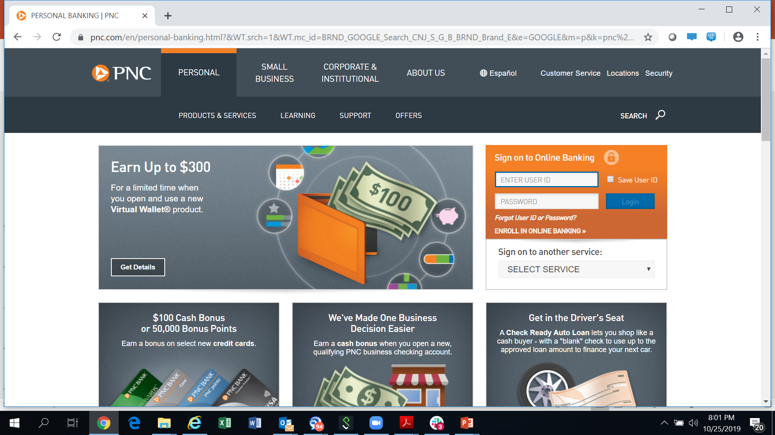



| Webinar Series
https://live.moodys.io/us-public-finance-in-focus-channel
Schedule & Materials
Get regular updates on the US Public Finance in Focus program
Sign-up Once
Engage with the analysts and get your questions answered
Live Q&A

Slide 3

Agenda
1
Introduction
2
States Sector Outlook
3
Local Governments Sector Outlook
4
Questions and Answers

Slide 4
1
Introduction

Slide 5
US States and Local Governments Outlooks 2024

Slide 6
2
States Sector Outlook

Slide 7
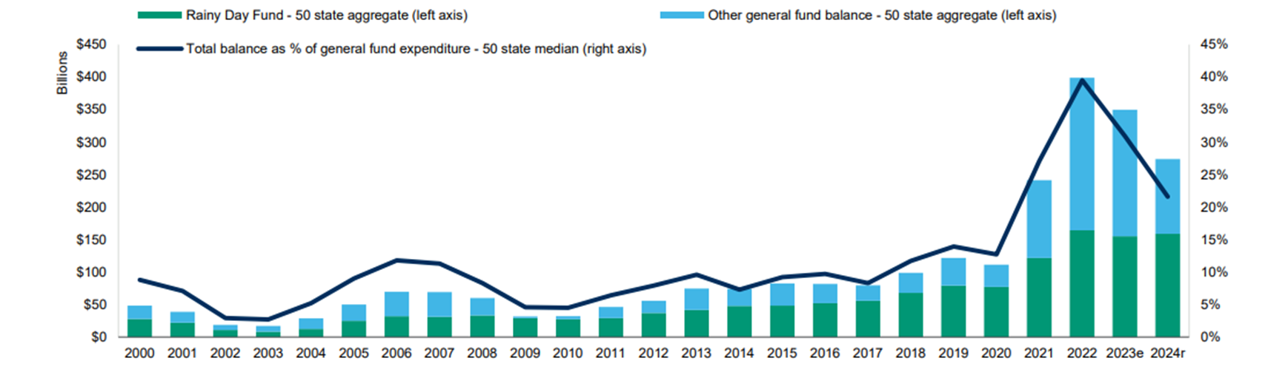
Reserves are declining but will remain near historic highs
e=estimate, r=recommended
Sources: National Association of State Budget Officers, Moody's Investors Service

Slide 8
US States and Local Governments Outlooks 2024

Slide 9
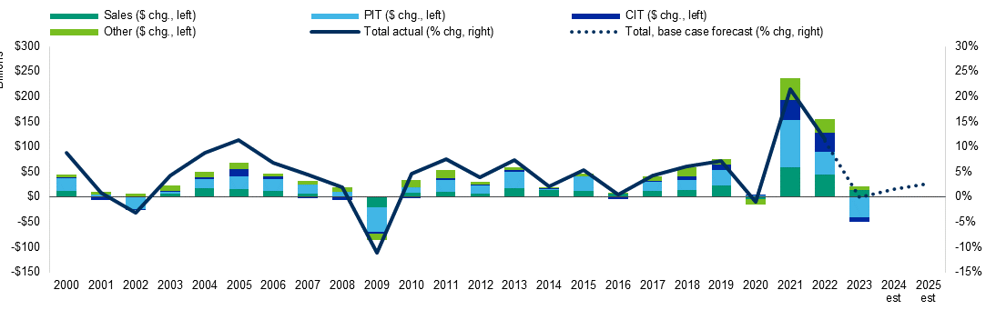
Median tax revenue growth
Years are on a calendar basis
PIT=personal or individual income taxes, CIT=corporate income taxes
Sources: US Census of State and Local Governments, Federal Reserve Bank of St. Louis, Moody's Investors Service

Slide 10
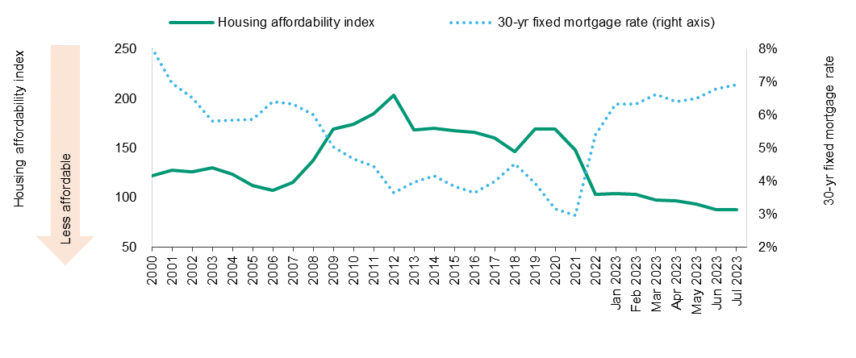
Housing affordability has deteriorated significantly
A housing affordability index of 100 means that a family with the median income has just enough income to afford a new mortgage on a median-priced home.
Chart shows annual averages for 2001-2022, monthly data for 2023
Sources: National Association of Realtors, Freddie Mac, Moody's Investors Service

Slide 11
3
Local Governments Sector Outlook

Slide 12
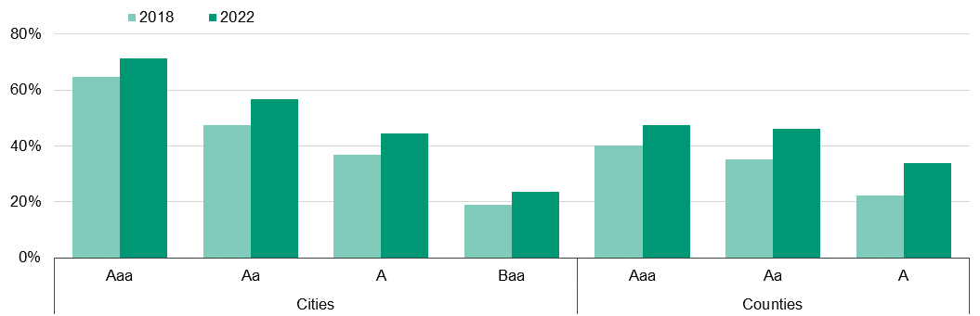
Reserves improved across rating categories
Median available fund balance improved across all rating categories between 2018 and 2022

Slide 13
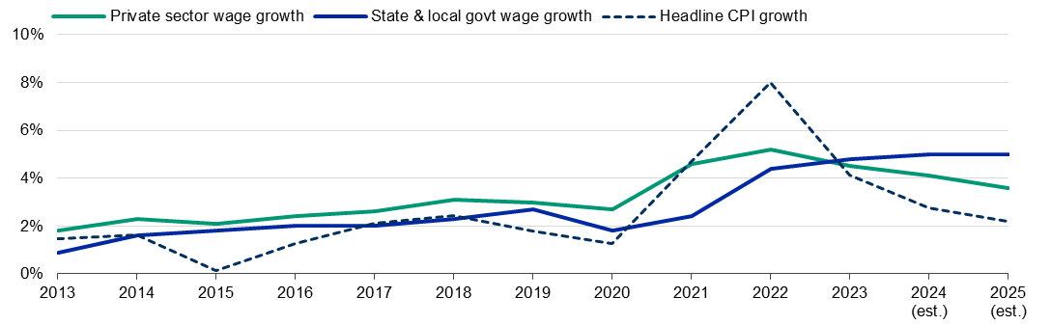
Wages will continue to grow above rate of inflation
Government wage growth likely to remain 4% to 5% in 2024 as cities and counties fill vacancies, compete with private sector and negotiate with bargaining units

Slide 14
US States and Local Governments Outlooks 2024

Slide 15
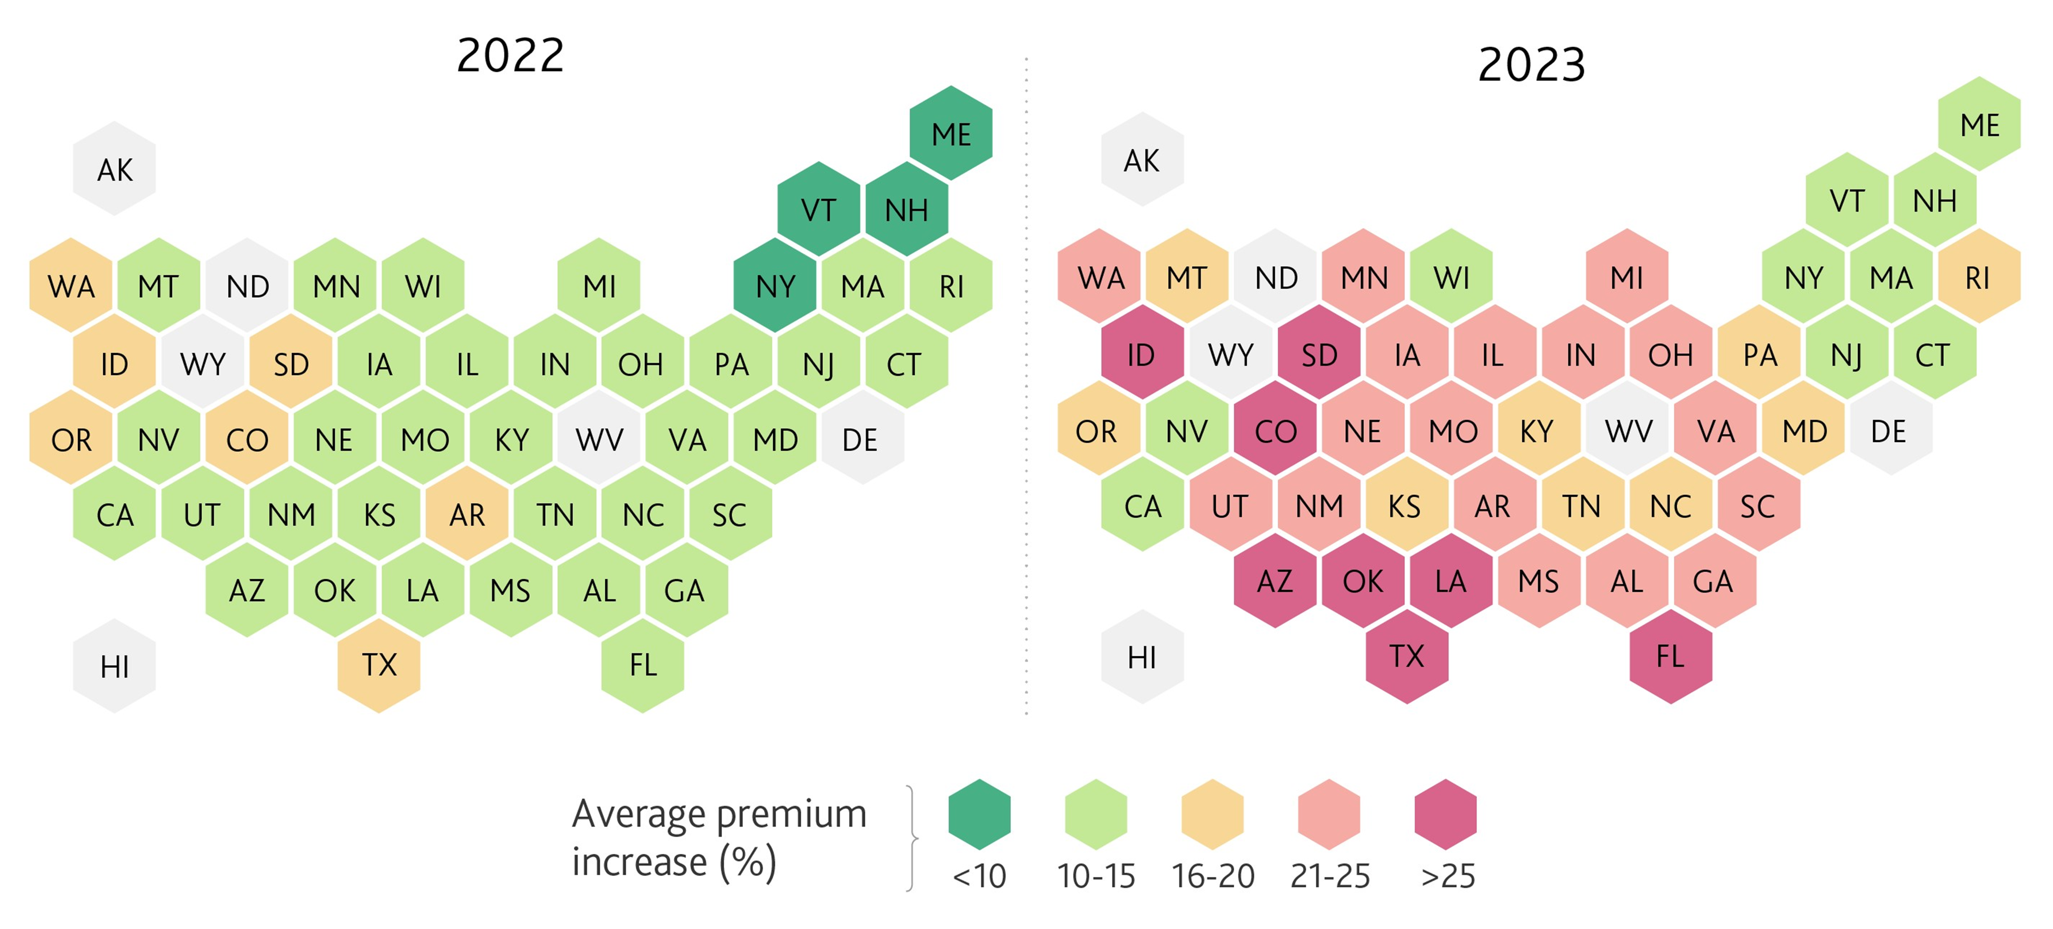
Increasing insurance costs reflect environmental risk, burden on homeowners
Increasing home costs, supply chain pressure and inflation also drivers of premium increases
2022 average increase: 12%
2023 average increase: 21%
Top 5 highest increases:
Florida 35%
Idaho 31%
Colorado 30%
South Dakota 28%
Louisiana, Oklahoma, Texas 27%

Slide 16
US States and Local Governments Outlooks 2024

Slide 17
Questions and Answers
YS States and Local Governments Outlooks 2024

Slide 18
Thank You
US Statea and Local Governments Outlook 2024

Slide 20
© 2023 Moody’s Corporation, Moody’s Investors Service, Inc., Moody’s Analytics, Inc. and/or their licensors and affiliates (collectively, “MOODY’S”). All rights reserved.
CREDIT RATINGS ISSUED BY MOODY'S CREDIT RATINGS AFFILIATES ARE THEIR CURRENT OPINIONS OF THE RELATIVE FUTURE CREDIT RISK OF ENTITIES, CREDIT COMMITMENTS, OR DEBT OR DEBT-LIKE SECURITIES, AND MATERIALS, PRODUCTS, SERVICES AND INFORMATION PUBLISHED BY MOODY’S (COLLECTIVELY, “PUBLICATIONS”) MAY INCLUDE SUCH CURRENT OPINIONS. MOODY’S DEFINES CREDIT RISK AS THE RISK THAT AN ENTITY MAY NOT MEET ITS CONTRACTUAL FINANCIAL OBLIGATIONS AS THEY COME DUE AND ANY ESTIMATED FINANCIAL LOSS IN THE EVENT OF DEFAULT OR IMPAIRMENT. SEE APPLICABLE MOODY’S RATING SYMBOLS AND DEFINITIONS PUBLICATION FOR INFORMATION ON THE TYPES OF CONTRACTUAL FINANCIAL OBLIGATIONS ADDRESSED BY MOODY’S CREDIT RATINGS. CREDIT RATINGS DO NOT ADDRESS ANY OTHER RISK, INCLUDING BUT NOT LIMITED TO: LIQUIDITY RISK, MARKET VALUE RISK, OR PRICE VOLATILITY. CREDIT RATINGS, NON-CREDIT ASSESSMENTS (“ASSESSMENTS”), AND OTHER OPINIONS INCLUDED IN MOODY’S PUBLICATIONS ARE NOT STATEMENTS OF CURRENT OR HISTORICAL FACT. MOODY’S PUBLICATIONS MAY ALSO INCLUDE QUANTITATIVE MODEL-BASED ESTIMATES OF CREDIT RISK AND RELATED OPINIONS OR COMMENTARY PUBLISHED BY MOODY’S ANALYTICS, INC. AND/OR ITS AFFILIATES. MOODY’S CREDIT RATINGS, ASSESSMENTS, OTHER OPINIONS AND PUBLICATIONS DO NOT CONSTITUTE OR PROVIDE INVESTMENT OR FINANCIAL ADVICE, AND MOODY’S CREDIT RATINGS, ASSESSMENTS, OTHER OPINIONS AND PUBLICATIONS ARE NOT AND DO NOT PROVIDE RECOMMENDATIONS TO PURCHASE, SELL, OR HOLD PARTICULAR SECURITIES. MOODY’S CREDIT RATINGS, ASSESSMENTS, OTHER OPINIONS AND PUBLICATIONS DO NOT COMMENT ON THE SUITABILITY OF AN INVESTMENT FOR ANY PARTICULAR INVESTOR. MOODY’S ISSUES ITS CREDIT RATINGS, ASSESSMENTS AND OTHER OPINIONS AND PUBLISHES ITS PUBLICATIONS WITH THE EXPECTATION AND UNDERSTANDING THAT EACH INVESTOR WILL, WITH DUE CARE, MAKE ITS OWN STUDY AND EVALUATION OF EACH SECURITY THAT IS UNDER CONSIDERATION FOR PURCHASE, HOLDING, OR SALE.
MOODY’S CREDIT RATINGS, ASSESSMENTS, OTHER OPINIONS, AND PUBLICATIONS ARE NOT INTENDED FOR USE BY RETAIL INVESTORS AND IT WOULD BE RECKLESS AND INAPPROPRIATE FOR RETAIL INVESTORS TO USE MOODY’S CREDIT RATINGS, ASSESSMENTS, OTHER OPINIONS OR PUBLICATIONS WHEN MAKING AN INVESTMENT DECISION. IF IN DOUBT YOU SHOULD CONTACT YOUR FINANCIAL OR OTHER PROFESSIONAL ADVISER.
ALL INFORMATION CONTAINED HEREIN IS PROTECTED BY LAW, INCLUDING BUT NOT LIMITED TO, COPYRIGHT LAW, AND NONE OF SUCH INFORMATION MAY BE COPIED OR OTHERWISE REPRODUCED, REPACKAGED, FURTHER TRANSMITTED, TRANSFERRED, DISSEMINATED, REDISTRIBUTED OR RESOLD, OR STORED FOR SUBSEQUENT USE FOR ANY SUCH PURPOSE, IN WHOLE OR IN PART, IN ANY FORM OR MANNER OR BY ANY MEANS WHATSOEVER, BY ANY PERSON WITHOUT MOODY’S PRIOR WRITTEN CONSENT.
MOODY’S CREDIT RATINGS, ASSESSMENTS, OTHER OPINIONS AND PUBLICATIONS ARE NOT INTENDED FOR USE BY ANY PERSON AS A BENCHMARK AS THAT TERM IS DEFINED FOR REGULATORY PURPOSES AND MUST NOT BE USED IN ANY WAY THAT COULD RESULT IN THEM BEING CONSIDERED A BENCHMARK.
All information contained herein is obtained by MOODY’S from sources believed by it to be accurate and reliable. Because of the possibility of human or mechanical error as well as other factors, however, all information contained herein is provided “AS IS” without warranty of any kind. MOODY'S adopts all necessary measures so that the information it uses in assigning a credit rating is of sufficient quality and from sources MOODY'S considers to be reliable including, when appropriate, independent third-party sources. However, MOODY’S is not an auditor and cannot in every instance independently verify or validate information received in the credit rating process or in preparing its Publications.
To the extent permitted by law, MOODY’S and its directors, officers, employees, agents, representatives, licensors and suppliers disclaim liability to any person or entity for any indirect, special, consequential, or incidental losses or damages whatsoever arising from or in connection with the information contained herein or the use of or inability to use any such information, even if MOODY’S or any of its directors, officers, employees, agents, representatives, licensors or suppliers is advised in advance of the possibility of such losses or damages, including but not limited to: (a) any loss of present or prospective profits or (b) any loss or damage arising where the relevant financial instrument is not the subject of a particular credit rating assigned by MOODY’S.
To the extent permitted by law, MOODY’S and its directors, officers, employees, agents, representatives, licensors and suppliers disclaim liability for any direct or compensatory losses or damages caused to any person or entity, including but not limited to by any negligence (but excluding fraud, willful misconduct or any other type of liability that, for the avoidance of doubt, by law cannot be excluded) on the part of, or any contingency within or beyond the control of, MOODY’S or any of its directors, officers, employees, agents, representatives, licensors or suppliers, arising from or in connection with the information contained herein or the use of or inability to use any such information.
NO WARRANTY, EXPRESS OR IMPLIED, AS TO THE ACCURACY, TIMELINESS, COMPLETENESS, MERCHANTABILITY OR FITNESS FOR ANY PARTICULAR PURPOSE OF ANY CREDIT RATING, ASSESSMENT, OTHER OPINION OR INFORMATION IS GIVEN OR MADE BY MOODY’S IN ANY FORM OR MANNER WHATSOEVER.
Moody’s Investors Service, Inc., a wholly-owned credit rating agency subsidiary of Moody’s Corporation (“MCO”), hereby discloses that most issuers of debt securities (including corporate and municipal bonds, debentures, notes and commercial paper) and preferred stock rated by Moody’s Investors Service, Inc. have, prior to assignment of any credit rating, agreed to pay to Moody’s Investors Service, Inc. for credit ratings opinions and services rendered by it fees ranging from $1,000 to approximately $5,000,000. MCO and Moody’s Investors Service also maintain policies and procedures to address the independence of Moody’s Investors Service credit ratings and credit rating processes. Information regarding certain affiliations that may exist between directors of MCO and rated entities, and between entities who hold credit ratings from Moody’s Investors Service, Inc. and have also publicly reported to the SEC an ownership interest in MCO of more than 5%, is posted annually at www.moodys.com under the heading “Investor Relations — Corporate Governance — Charter Documents - Director and Shareholder Affiliation Policy.”
Additional terms for Australia only: Any publication into Australia of this document is pursuant to the Australian Financial Services License of MOODY’S affiliate, Moody’s Investors Service Pty Limited ABN 61 003 399 657AFSL 336969 and/or Moody’s Analytics Australia Pty Ltd ABN 94 105 136 972 AFSL 383569 (as applicable). This document is intended to be provided only to “wholesale clients” within the meaning of section 761G of the Corporations Act 2001. By continuing to access this document from within Australia, you represent to MOODY’S that you are, or are accessing the document as a representative of, a “wholesale client” and that neither you nor the entity you represent will directly or indirectly disseminate this document or its contents to “retail clients” within the meaning of section 761G of the Corporations Act 2001. MOODY’S credit rating is an opinion as to the creditworthiness of a debt obligation of the issuer, not on the equity securities of the issuer or any form of security that is available to retail investors.
Additional terms for Japan only: Moody's Japan K.K. (“MJKK”) is a wholly-owned credit rating agency subsidiary of Moody's Group Japan G.K., which is wholly-owned by Moody’s Overseas Holdings Inc., a wholly-owned subsidiary of MCO. Moody’s SF Japan K.K. (“MSFJ”) is a wholly-owned credit rating agency subsidiary of MJKK. MSFJ is not a Nationally Recognized Statistical Rating Organization (“NRSRO”). Therefore, credit ratings assigned by MSFJ are Non-NRSRO Credit Ratings. Non-NRSRO Credit Ratings are assigned by an entity that is not a NRSRO and, consequently, the rated obligation will not qualify for certain types of treatment under U.S. laws. MJKK and MSFJ are credit rating agencies registered with the Japan Financial Services Agency and their registration numbers are FSA Commissioner (Ratings) No. 2 and 3 respectively.
MJKK or MSFJ (as applicable) hereby disclose that most issuers of debt securities (including corporate and municipal bonds, debentures, notes and commercial paper) and preferred stock rated by MJKK or MSFJ (as applicable) have, prior to assignment of any credit rating, agreed to pay to MJKK or MSFJ (as applicable) for credit ratings opinions and services rendered by it fees ranging from JPY100,000 to approximately JPY550,000,000.
MJKK and MSFJ also maintain policies and procedures to address Japanese regulatory requirements.

